Slide 1
Introduction to Lists, Basic List Operations, Built-in List Functions, List Methods
L3,L4,L5 and L6

Slide 2
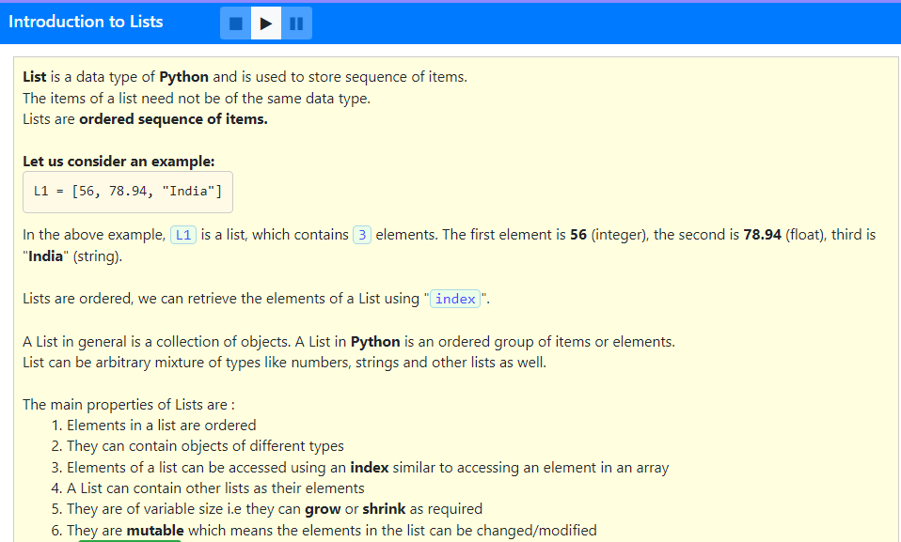

Slide 3
Which of the following is correct option?
1. All elements in a list should be of same data type.
2. Lists are immutable.
3. Lists are ordered and can contain other lists as elements.
4. Indexing can be used with lists to access individual items only if there are no nested lists.
1,2 and 3
2 and 3
3 only
4 only

Slide 4
Which of the following is correct option?
1. All elements in a list should be of same data type.
2. Lists are immutable.
3. Lists are ordered and can contain other lists as elements.
4. Indexing can be used with lists to access individual items only if there are no nested lists.
1,2 and 3
2 and 3
3 only
4 only

Slide 5
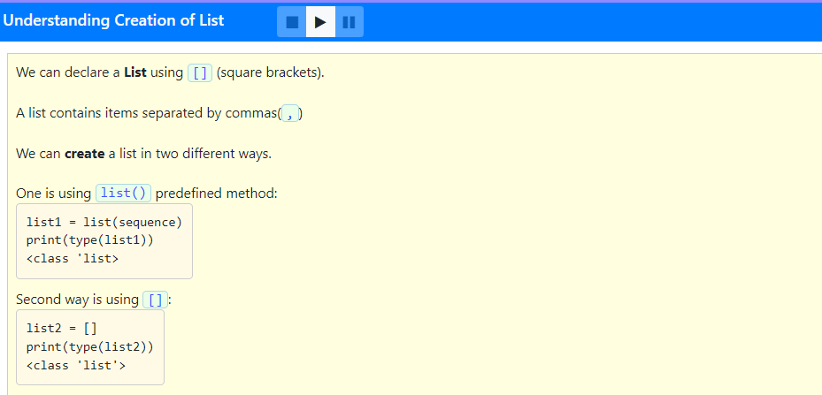

Slide 6
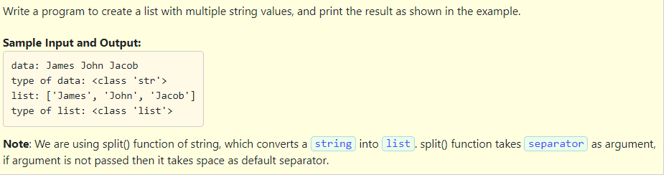
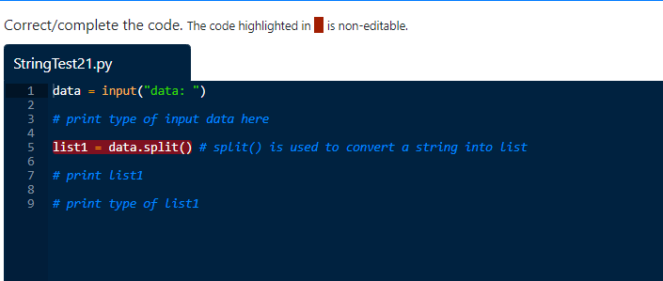

Slide 7
data = input("data: ")
print("type of data:", type(data))
list1 = data.split() # split() is used to convert a string into list
print("list:", list1)
print("type of list:", type(list1))

Slide 8
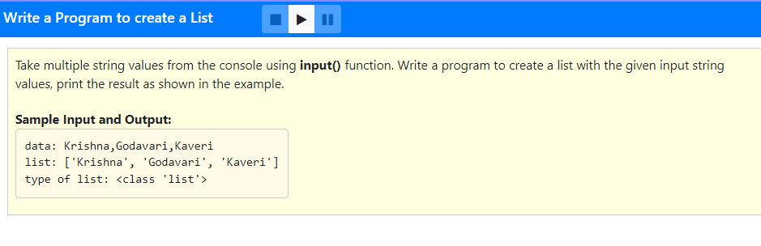

Slide 9
data = input("data: ")
list1 = data.split(",")
print("list:", list1)
print("type of list:", type(list1))

Slide 10
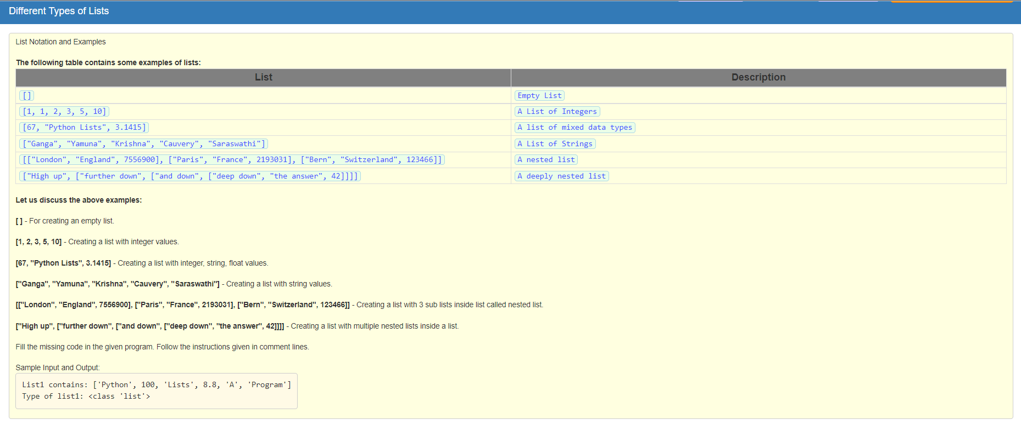

Slide 11
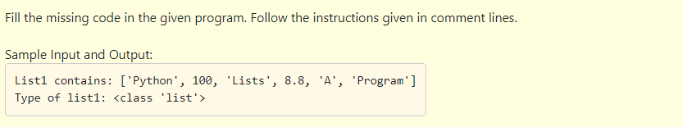

Slide 12
list1 = ["Python", 100, "Lists", 8.8,'A', "Program"]
# print the list1 items
print("List1 contains:",list1)
# print the type of list1
print("Type of list1:",type(list1))

Slide 13
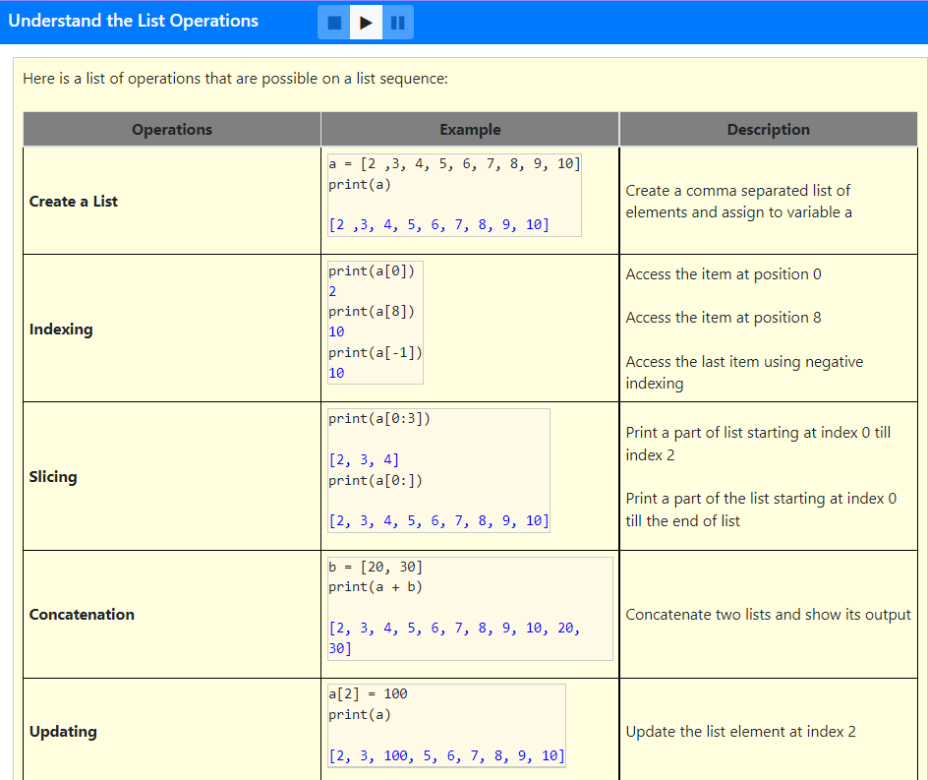
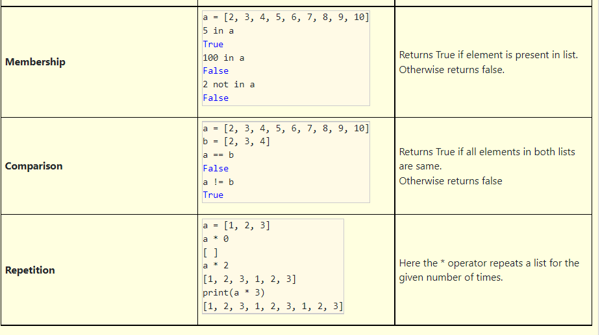

Slide 14
Which of the following option is correct?
1. l1 = [1, 20, 30, 40] index of l1 starts from 0.
2. Lists are immutable we are unable to update the list.
3. a = [100, 23, 32] print(a * 0) returns [100, 23, 32].
1 and 2
2 and 3
1 only
3 only

Slide 15
Which of the following option is correct?
1. l1 = [1, 20, 30, 40] index of l1 starts from 0.
2. Lists are immutable we are unable to update the list.
3. a = [100, 23, 32] print(a * 0) returns [100, 23, 32].
1 and 2
2 and 3
1 only
3 only

Slide 16
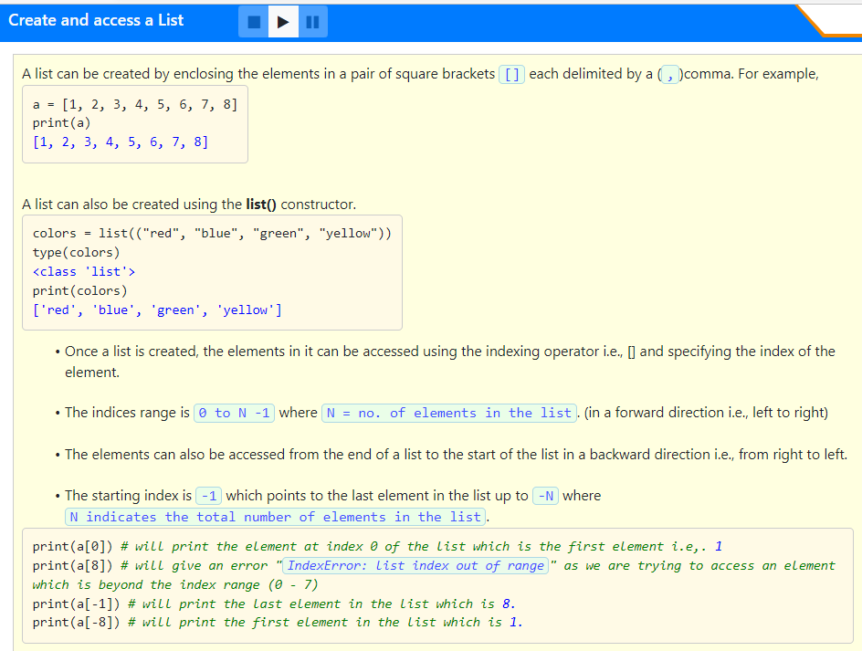

Slide 17
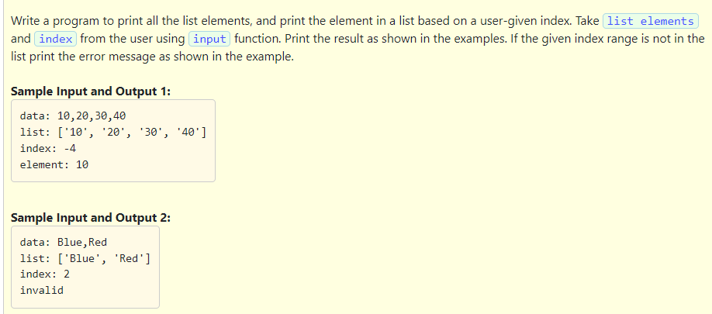

Slide 18
data = input("data: ")
list1 = data.split(",")
print("list:", list1)
index = int(input("index: "))
if index < len(list1) and index >= -(len(list1)):
print("element:", list1[index])
else:
print("invalid")

Slide 19
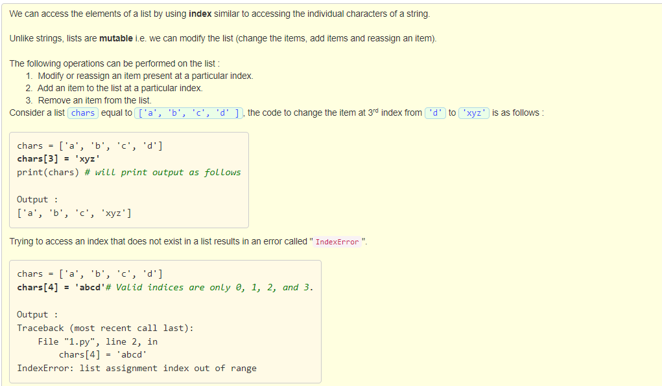

Slide 20
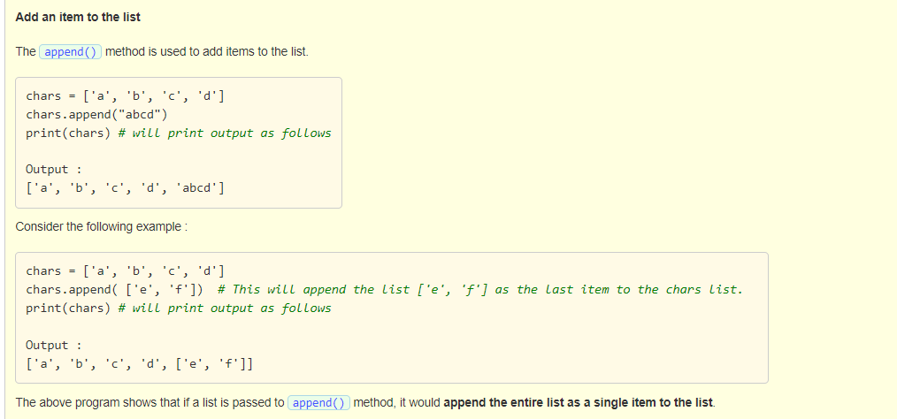

Slide 21
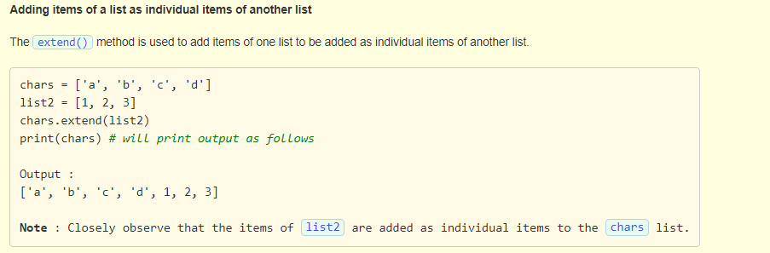

Slide 22
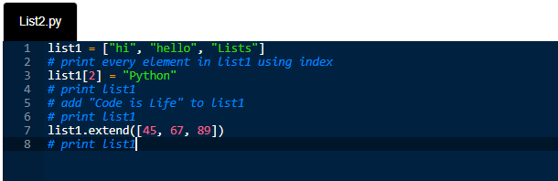
Fill in the missing code in the below program. Follow the instructions given in comment lines.

Slide 23
Solution:
list1 = ["hi", "hello", "Lists"]
print(list1[0])
print(list1[1])
print(list1[2])
list1[2] = "Python"
print(list1)
list1.append("Code is Life")
print(list1)
list1.extend([45, 67, 89])
print(list1)

Slide 24
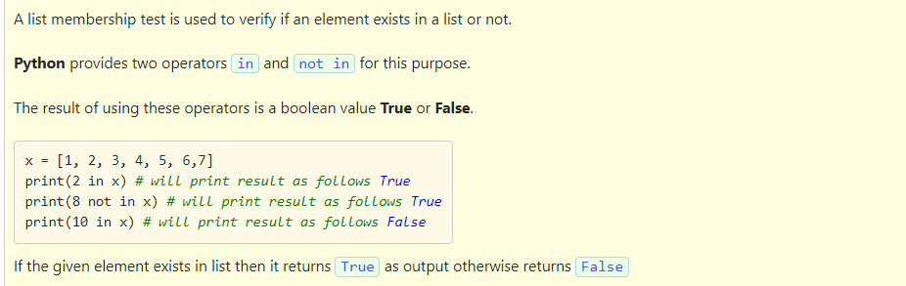

Slide 25
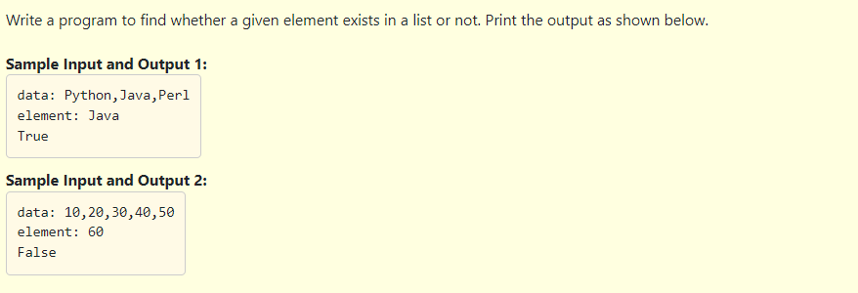

Slide 26
Solution:
data = input("data: ")
list1 = data.split(",")
element = input("element: ")
if element in list1:
print("True")
else:
print("False")

Slide 27
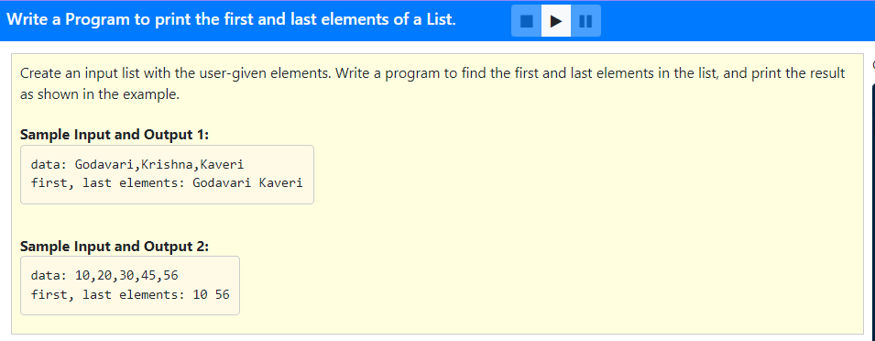

Slide 28
data = input("data: ")
list1 = data.split(",")
print("first, last elements:", list1[0], list1[-1])

Slide 29
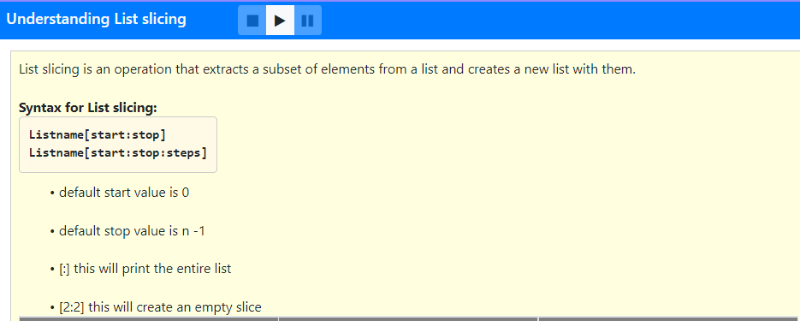
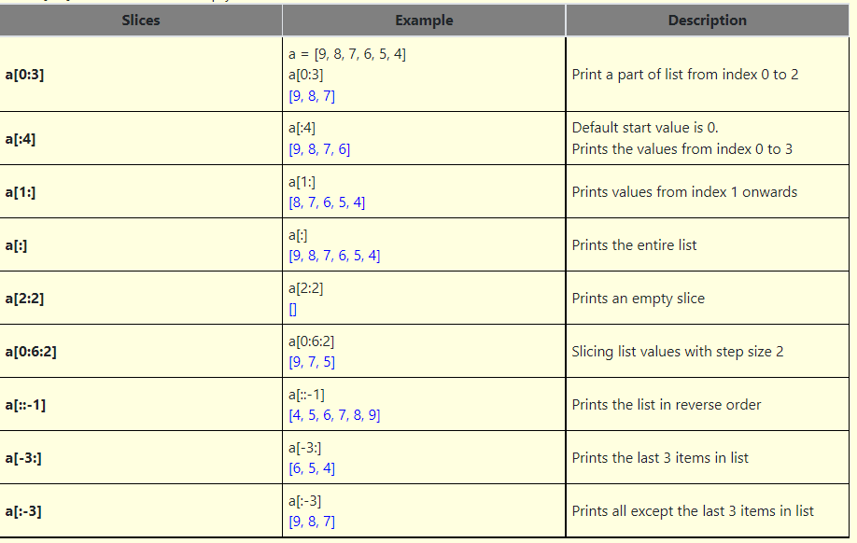

Slide 30
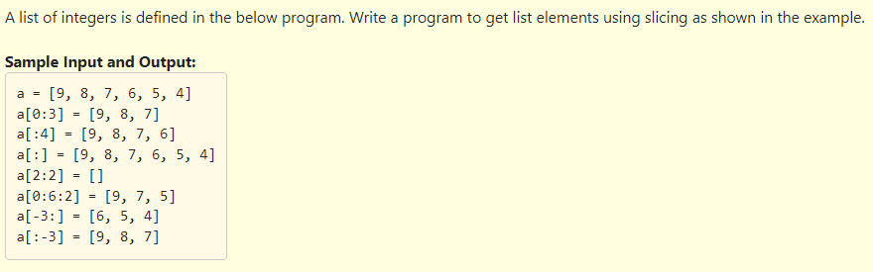
Solution:
a = [9, 8, 7, 6, 5, 4]
print("a =", a)
print("a[0:3] =", a[0:3])
print("a[:4] =", a[:4])
print("a[:] =", a[:])
print("a[2:2] =", a[2:2])
print("a[0:6:2] =", a[0:6:2])
print("a[-3:] =", a[-3:])
print("a[:-3] =", a[:-3])

Slide 31
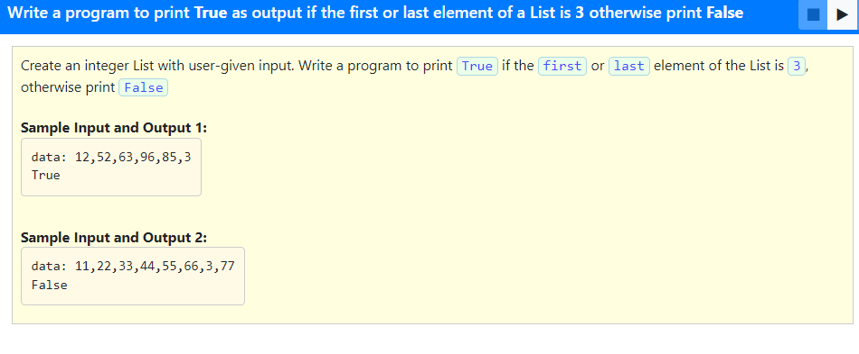

Slide 32
Solution:
data = input("data: ")
list1 = data.split(",")
for i in range(0, len(list1)):
list1[i] = int(list1[i])
if (list1[0] == 3) or (list1[-1] == 3):
print("True")
else:
print("False")

Slide 33
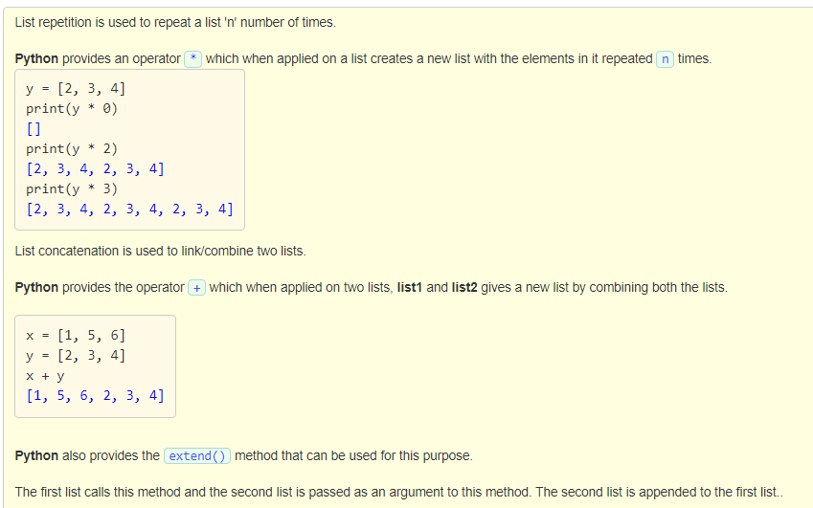

Slide 34
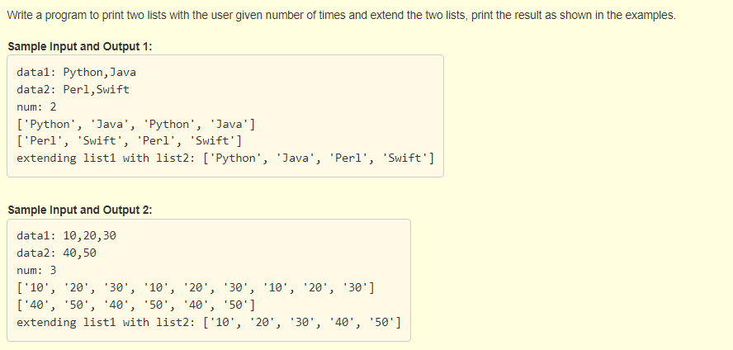

Slide 35
Solution:
data1 = input("data1: ")
list1 = data1.split(",")
data2 = input("data2: ")
list2 = data2.split(",")
num = int(input("num: "))
print(list1 * num)
print(list2 * num)
list1.extend(list2)
print("extending list1 with list2:", list1)

Slide 36
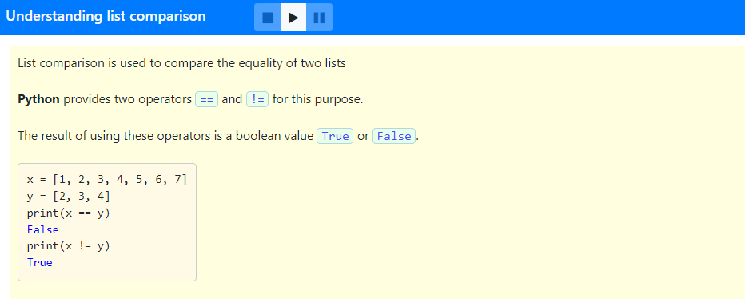

Slide 37
Solution:
data1 = input("data1: ")
list1 = data1.split(",")
data2 = input("data2: ")
list2 = data2.split(",")
print("is equal:", list1 == list2)
print("is not equal:", list1 != list2)

Slide 38
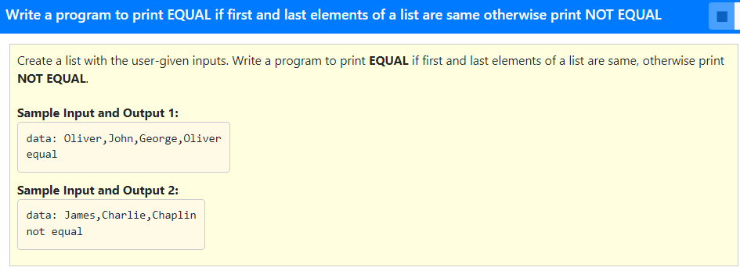

Slide 39
Solution:
data = input("data: ")
list1 = data.split(",")
if list1[0] == list1[-1]:
print("equal")
else:
print("not equal")

Slide 40
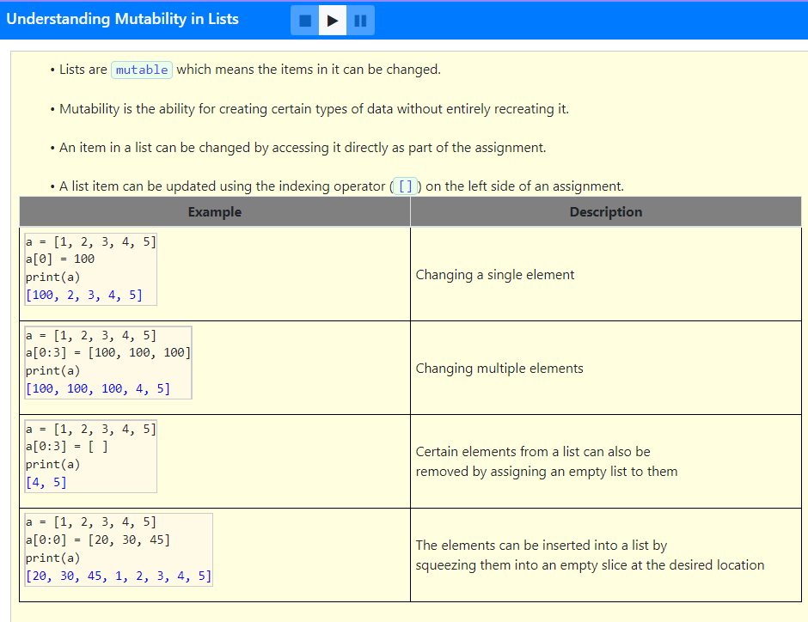

Slide 41
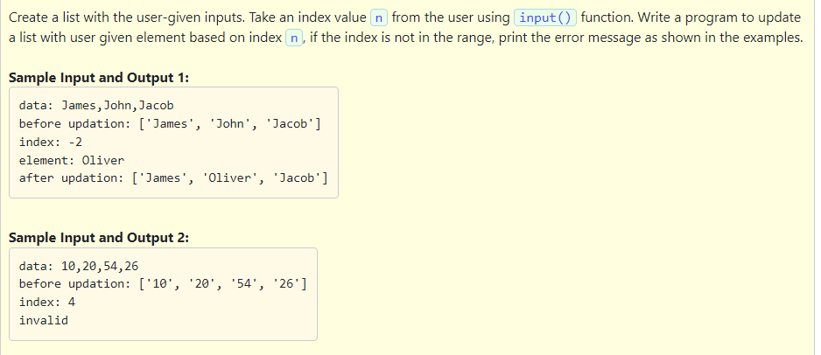

Slide 42
Solution:
data = input("data: " )
list1 = data.split(",")
print("before updation:", list1)
index = int(input("index: "))
if index < len(list1) and index >= -(len(list1)):
value = input("element: ")
list1[index] = value
print("after updation:", list1)
else:
print("invalid")

Slide 43
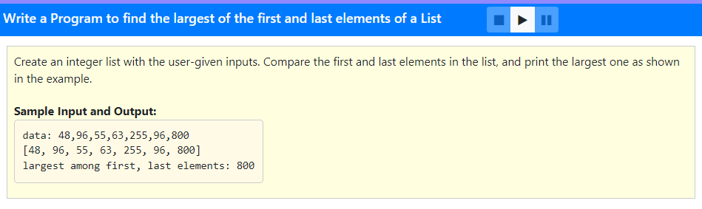

Slide 44
data = input("data: ")
list1 = data.split(",")
size = len(list1)
for i in range(size):
list1[i] = int(list1[i])
print(list1)
if list1[0] < list1[-1]:
print("largest among first, last elements:", list1[-1])
else:
print("largest among first, last elements:", list1[0])

Slide 45
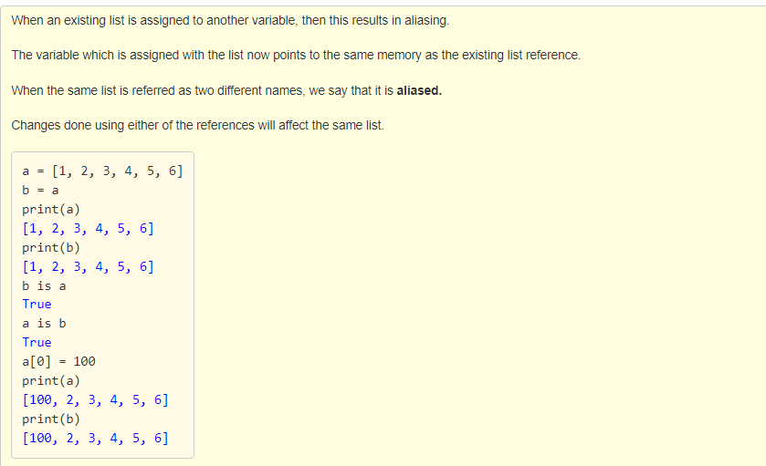

Slide 46
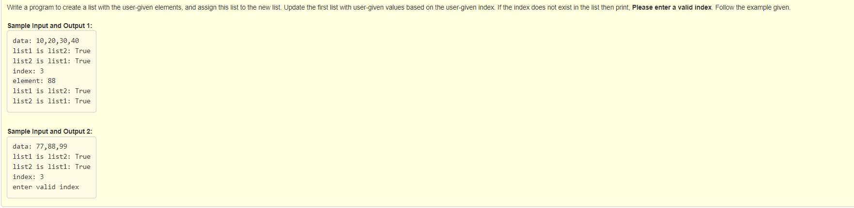

Slide 47
data = input("data: ")
list1 = data.split(",")
list2 = []
list2 = list1
print("list1 is list2:", list1 is list2)
print("list2 is list1:", list2 is list1)
index = int(input("index: "))
if index < len(list1) and index >= -(len(list1)):
element = input("element: ")
list1[index] = element
print("list1 is list2:", list1 is list2)
print("list2 is list1:", list2 is list1)
else:
print("enter valid index")

Slide 48
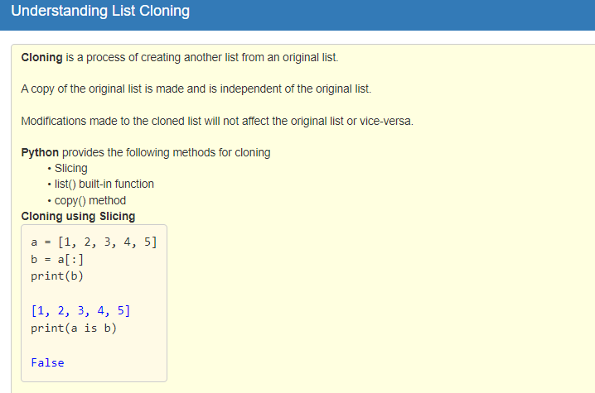
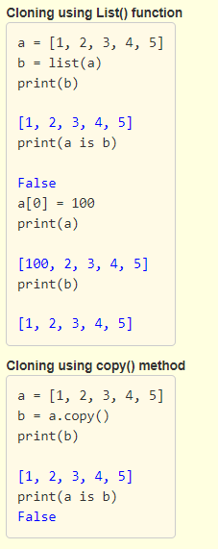

Slide 49
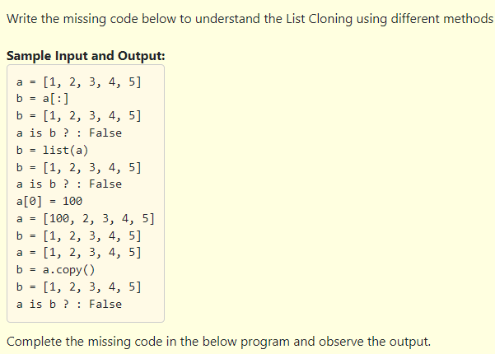
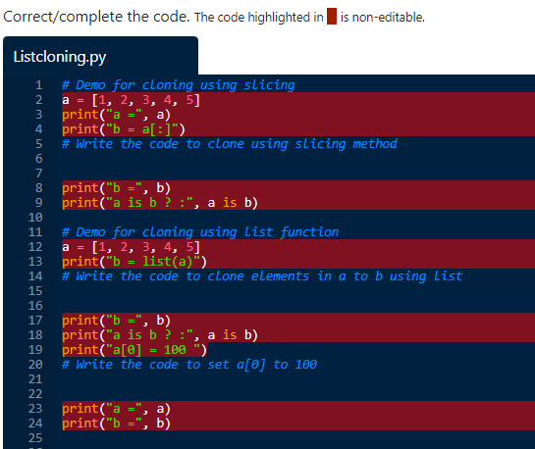
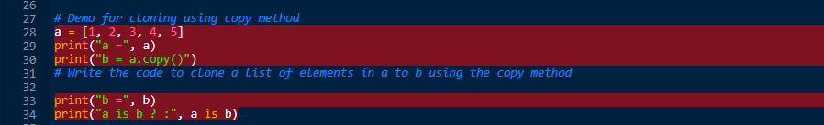

Slide 50
#cloning using slicing
a = [1, 2, 3, 4, 5]
print("a =", a)
print("b = a[:]")
b = a[:]
print("b =", b)
print("a is b ? :", a is b)
#cloning using list function
a = [1, 2, 3, 4, 5]
print("b = list(a)")
b = list(a)
print("b =", b)
print("a is b ? :", a is b)
print("a[0] = 100 ")
a[0] = 100
print("a =", a)
print("b =", b)
#cloning using copy method
a = [1, 2, 3, 4, 5]
print("a =", a)
print("b = a.copy()")
b = a.copy()
print("b =", b)
print("a is b ? :", a is b)

Slide 51
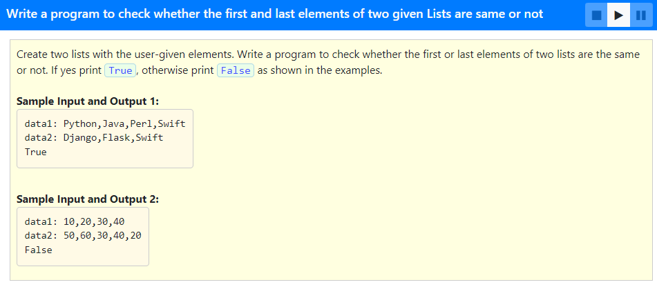

Slide 52
data1 = input("data1: ")
list1 = data1.split(",")
data2 = input("data2: ")
list2 = data2.split(",")
if list1[0] == list2[0] or list1[-1] == list2[-1]:
print("True")
else:
print("False")

Slide 53
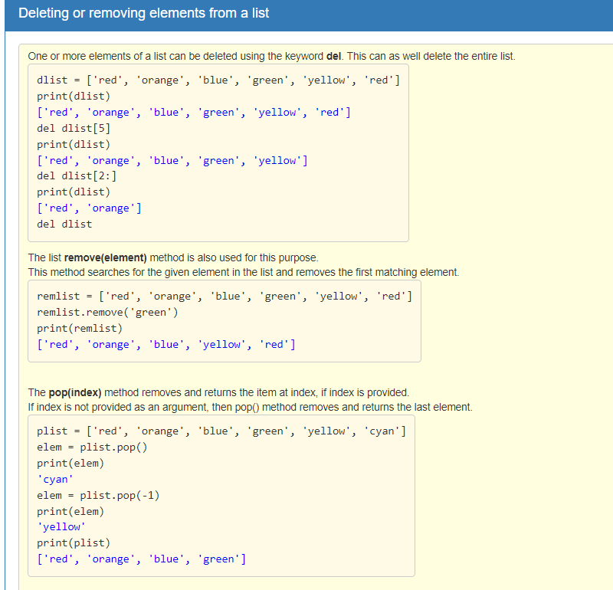
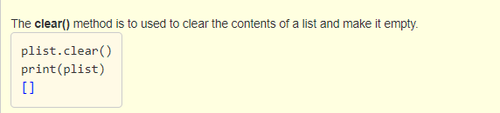

Slide 54
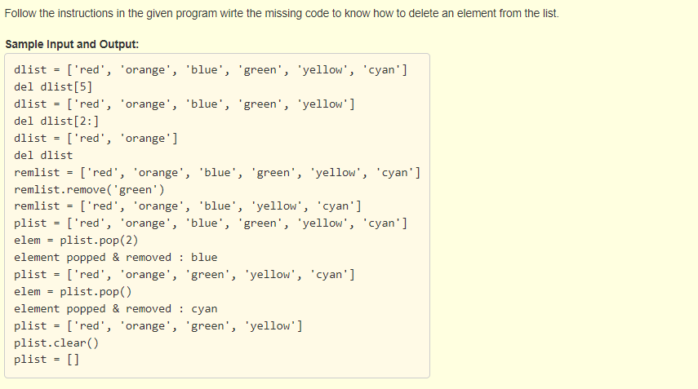
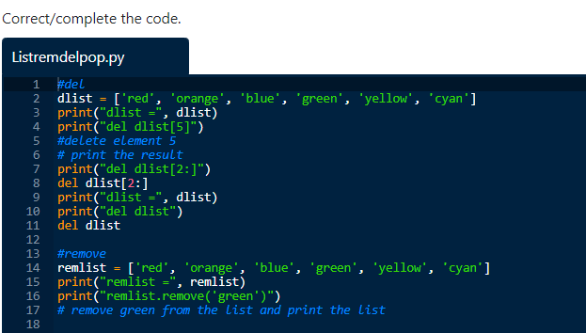
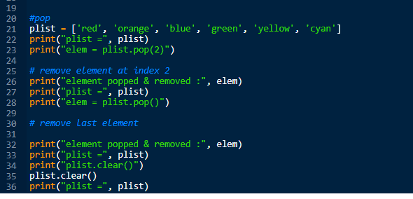

Slide 55
#del
dlist = ['red', 'orange', 'blue', 'green', 'yellow', 'cyan']
print("dlist =", dlist)
print("del dlist[5]")
del dlist[5]
print("dlist =", dlist)
print("del dlist[2:]")
del dlist[2:]
print("dlist =", dlist)
print("del dlist")
del dlist
#remove
remlist = ['red', 'orange', 'blue', 'green', 'yellow', 'cyan']
print("remlist =", remlist)
print("remlist.remove('green')")
remlist.remove('green')
print("remlist =", remlist)
#pop
plist = ['red', 'orange', 'blue', 'green', 'yellow', 'cyan']
print("plist =", plist)
print("elem = plist.pop(2)")
elem = plist.pop(2)
print("element popped & removed :", elem)
print("plist =", plist)
print("elem = plist.pop()")
elem = plist.pop()
print("element popped & removed :", elem)
print("plist =", plist)
print("plist.clear()")
plist.clear()
print("plist =", plist)

Slide 56
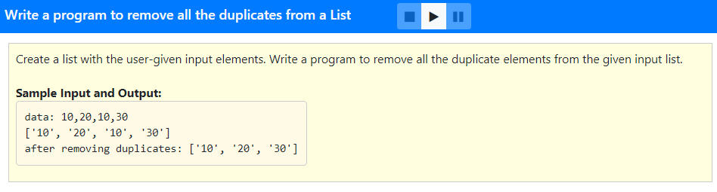

Slide 57
data = input("data: ")
list1 = data.split(",")
list2 = []
for i in range(len(list1)):
if list1[i] not in list2:
list2.append(list1[i])
print(list1)
print("after removing duplicates:", list2)

Slide 58
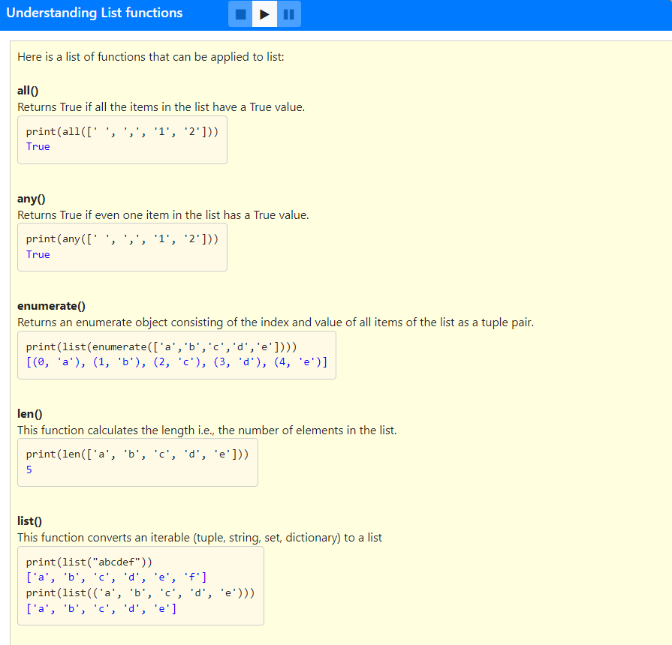
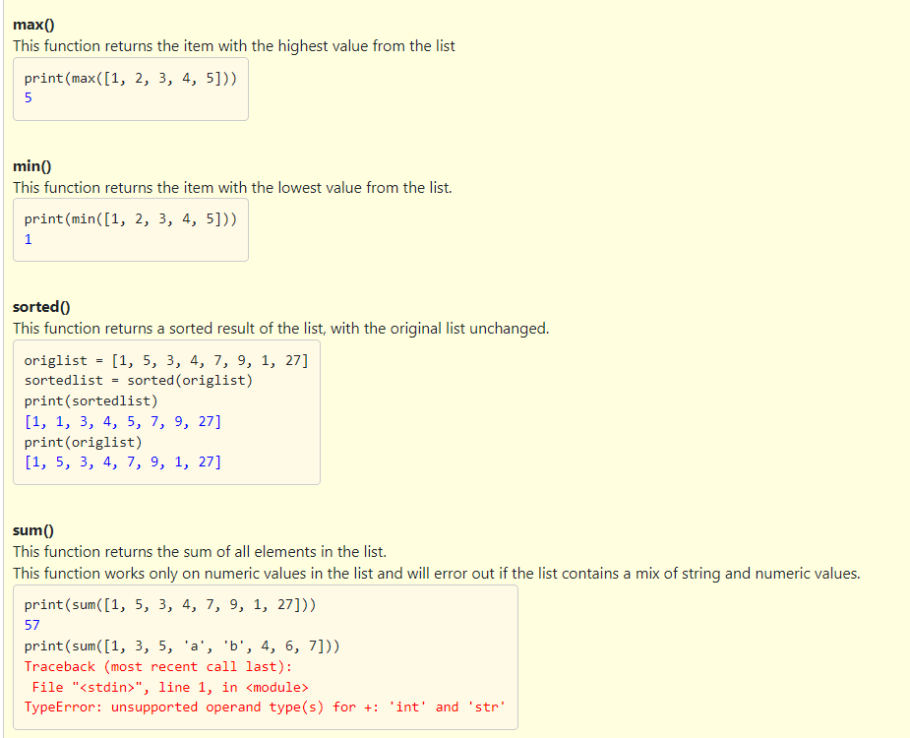

Slide 59
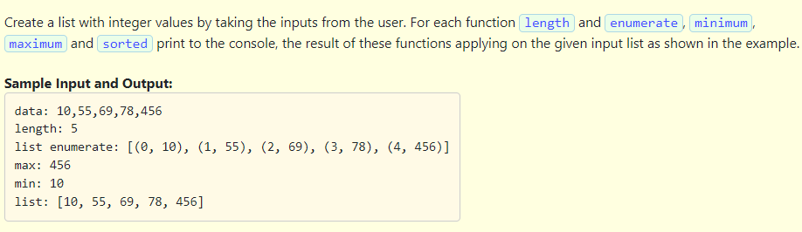

Slide 60
Solution:
data = input("data: ")
list1 = data.split(",")
size = len(list1)
for i in range(size):
list1[i] = int(list1[i])
print("length:", size)
print("list enumerate:", list(enumerate(list1)))
print("max:", max(list1))
print("min:", min(list1))
print("list:", sorted(list1))

Slide 61
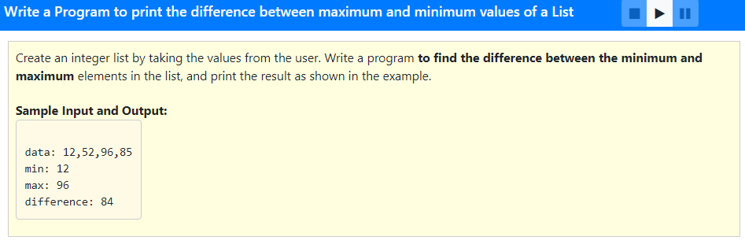

Slide 62
Solution:
data = input("data: ")
list1 = data.split(",")
size = len(list1)
for i in range(size):
list1[i] = int(list1[i])
max_val = max(list1)
min_val = min(list1)
print("min:", min_val)
print("max:", max_val)
difference = max_val - min_val
print("difference:", difference)

Slide 63
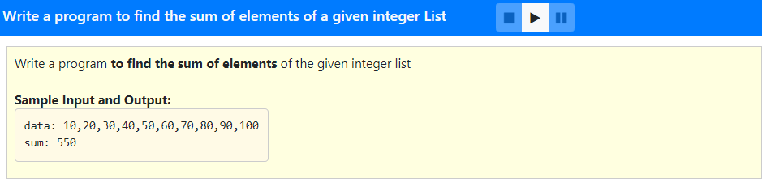

Slide 64
Solution:
data1 = input("data: ")
list1 = data1.split(",")
size1 = len(list1)
for i in range(size1):
list1[i] = int(list1[i])
sum = 0
for i in range(size1):
sum = sum+list1[i]
print("sum:", sum)

Slide 65
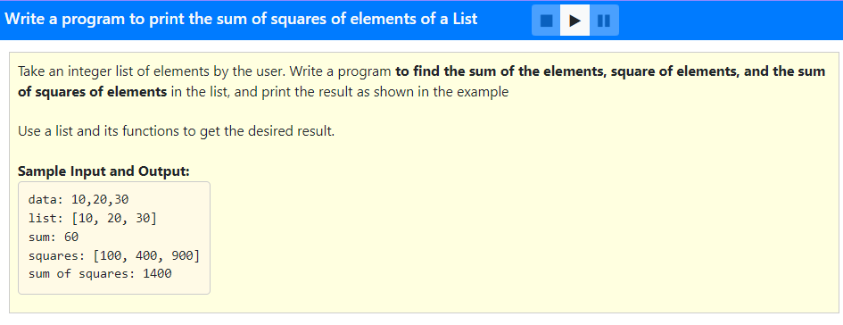

Slide 66
data = input("data: ")
list1 = data.split(",")
size = len(list1)
for i in range(size):
list1[i] = int(list1[i])
s = sum(list1)
print("list:", list1)
print("sum:", s)
for i in range(size):
list1[i] = list1[i] * list1[i]
print("squares:", list1)
print("sum of squares:", sum(list1))

Slide 67
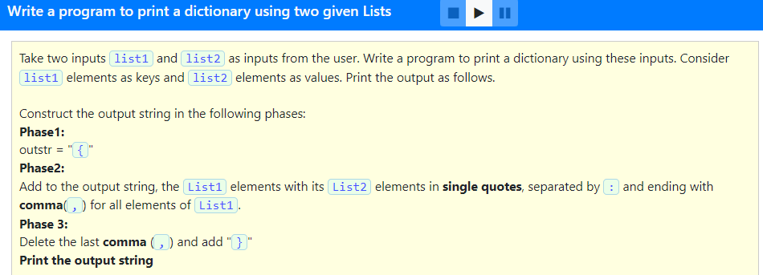


Slide 68
Solution:
data1=input("data1: ")
data2=input("data2: ")
l1=data1.split(",")
l2=data2.split(",")
str1='{'
if len(l1)!=len(l2):
print("lists are different lengths")
exit()
else:
for i in range(len(l1)):
str1=str1+"'"+l1[i]+"'"+":"+"'"+l2[i]+"'"+","
print(str1[0:len(str1)-1]+"}")

Slide 69


Slide 70
Solution:
data1 = input("data1: ")
list1 = data1.split(",")
data2 = input("data2: ")
list2 = data2.split(",")
size1 = len(list1)
size2 = len(list2)
if(size1 == size2):
for i in range(size1):
list1[i] = int(list1[i])
for i in range(size2):
list2[i] = int(list2[i])
list3 = []
for i in range(0, len(list1)):
list3.append(abs(list1[i] - list2[i]))
print(list3)
else:
print("lists are different lengths")

Slide 71




Slide 72


Slide 73


Slide 74
Solution:
data = input("data1: ")
list1 = data.split(",")
element = input("element: ")
list1.append(element)
print("after append:", list1)
data1 = input("data2: ")
list2 = data1.split(",")
list1.append(list2)
print("after append:", list1)
list1.extend(list2)
print("after extending:", list1)

Slide 75


Slide 76
#Program to reverse a list
data = input("data: ")
list1 = data.split(",")
list1.reverse()
print("reverse:", list1)

Slide 77


Slide 78
data = input("data: ")
list1 = data.split(",")
size = len(list1)
for i in range(size):
list1[i] = int(list1[i])
count = 0
element = int(input("element: "))
for i in range(0, len(list1)):
if list1[i] == element:
count = count + 1
print(element, "occurs", count, "times")

Slide 79


Slide 80
data = input("data: ")
list1 = data.split(",")
for i in range(0, len(list1)):
list1[i] = int(list1[i])
sum1 = 0
for i in range(0, len(list1)):
sum1 = sum1 + list1[i]
print("sum:", sum1)

Slide 81


Slide 82
data = input("data: ")
my_list = data.split(",")
size = len(my_list)
for i in range(size):
my_list[i] = int(my_list[i])
print("list:", my_list)
find = int(input("num: "))
for i in range(0, len(my_list) - 1):
if my_list[i] == find:
if my_list[i + 1] == find:
result = "True"
break
else:
result = "False"
print(result)

Slide 83


Slide 84
data = input("data: ")
big = data.split(",")
for i in range(0, len(big)):
big[i] = int(big[i])
sub = input("seq of elements: ")
small = sub.split(",")
for i in range(0, len(small)):
small[i] = int(small[i])
count=0
for i in range(len(small)):
for j in range(len(big)):
if small[i] == big[j]:
count=count+1
break
if count==len(small):
print("exist")
else:
print("does not exist")

Slide 85


Slide 86
#program to create new list of odd indexed elements from a given list
data = input("data: ")
list1 = data.split(",")
size = len(list1)
for i in range(size):
list1[i] = int(list1[i])
list2 = []
for i in range(0, len(list1)):
if( not i % 2 == 0):
list2.append(list1[i])
print("odd index elements:", list2)

Slide 87


Slide 88
capA = input("Please enter A in upper case: ")
smallA = input("Please enter A in lower case: ")
i = ord('A')
j = ord('a')
alpha = [ ]
for k in range(26):
alpha.append(chr(i))
alpha.append(chr(j))
i = i + 1
j = j + 1
print(alpha)

Slide 89


Slide 90
data = input("data: ")
my_list = data.split(",")
size = len(my_list)
for i in range(size):
my_list[i] = int(my_list[i])
if my_list == sorted(list(my_list)):
print("True")
else:
print("False")

Slide 91


Slide 92
#Program to print char counts in a given sentence
str1 = input("Please enter a sentence: ")# Get the Input string
str2 = str1.lower() # Convert to lower case
str3 = sorted(str2) # Sort the string
printed = [] # Blank List
for char in str3: # For each character in the input
if char not in printed: # check whether printed or not
if char.isalpha(): # print only alphabet characters
print(char, "\t", str3.count(char))
printed.append(char) # add to printed list

Slide 93


Slide 94
list1 = []
size = int(input("size: "))
for i in range(0, size):
val = input("element: ")
list1.append(val)
print("list:", list1)

